Slide 1
14th session.
Cash Flow and Forecasting Balance Sheet
Notes:
We will deal with financial topics slowly because, finally, we have to use numbers for things.

Slide 2
Source and application of funds
Sources:
(Cash inflows)
Shareholders contributions
Short-term debt
Long-term debt
Increase in accounts to pay
Decrease in accounts to collect
Sell fixed assets
Sell products and services
Applications:
(Cash outflows)
Debt cancellations
Buy fixed assets
Increase in accounts to collect
Decrease in accounts to pay
Pay dividends or simila concepts to shareholders
Pay operational expenses
CASH
Notes:
Slide explanation.

Slide 3

Balance Sheet 0

Slide 4
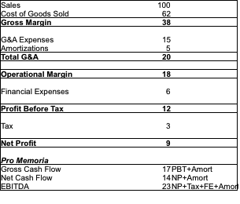
P&L Period 1

Slide 5

Balance Sheet 1

